Slide 1

Q:
What is the impact of 2013 Light to Moderate magnitude earthquakes to the City’s Per Capita Income?

Slide 2
Test Population
Zips that experienced Light to Moderate magnitude earthquake in 2013
Analysis performed at the Zip level of the City nearest to seismic location. Observed population range of 11,000 to 50,000
Earthquake Magnitude Classes
Class | Magnitude
Great | 8 or more
Major | 7 - 7.9
Strong | 6 - 6.9
Moderate | 5 - 5.9
Light | 4 - 4.9
Minor | 3 -3.9

Slide 3
Test Population
19 Zips that experienced Light to Moderate Magnitude of Seismic Activity in 2013
cd_by_year | Nrst City | ZIP | mag | title | Nrst Country | Population_2013 | Per Capita Income_2013 | Per Capita Income_2012 | PCI Change
2013 | susanville | 96130 | 5.69 | M 5.7 - 10km WNW of Greenville, California | us | 21,963 | $ 18,621.00 | $ 19,269.00 | -3%
2013 | fallon | 89406 | 5.1 | M 5.1 - 72km W of Tonopah, Nevada | us | 24,572 | $ 24,716.00 | $ 25,134.00 | -2%
2013 | eureka | 95501 | 4.94 | M 4.9 - 53km WNW of Eureka, California | us | 23,704 | $ 21,122.00 | $ 22,540.00 | -6%
2013 | isla vista | 93117 | 4.8 | M 4.8 - 6km W of Isla Vista, CA | us | 54,251 | $ 22,722.00 | $ 23,379.00 | -3%
2013 | lander | 82520 | 4.8 | M 4.8 - 20km W of Fort Washakie, Wyoming | us | 13,778 | $ 24,971.00 | $ 24,668.00 | 1%
2013 | edmond | 73013 | 4.5 | M 4.5 - 9km ESE of Edmond, Oklahoma | us | 46,457 | $ 38,470.00 | $ 39,266.00 | -2%
2013 | clearlake | 95422 | 4.44 | M 4.4 - 5km WSW of Cobb, California | us | 15,427 | $ 16,552.00 | $ 16,247.00 | 2%
2013 | choctaw | 73020 | 4.4 | M 4.4 - 12km ENE of Luther, Oklahoma | us | 21,499 | $ 29,985.00 | $ 28,890.00 | 4%
2013 | fortuna | 95540 | 4.3 | M 4.3 - 59km W of Ferndale, California | us | 12,877 | $ 21,707.00 | $ 23,116.00 | -6%
2013 | nacogdoches | 75964 | 4.3 | M 4.3 - 3km WNW of Timpson, Texas | us | 19,648 | $ 17,313.00 | $ 17,043.00 | 2%
2013 | ridgecrest | 93555 | 4.3 | M 4.3 - 15km NW of Coso Junction, CA | us | 32,376 | $ 28,697.00 | $ 28,922.00 | -1%
2013 | tehachapi | 93561 | 4.29 | M 4.3 - 22km ESE of Bodfish, CA | us | 34,851 | $ 24,708.00 | $ 24,369.00 | 1%
2013 | yucca valley | 92284 | 4.28 | M 4.3 - 12km W of Ludlow, CA | us | 24,951 | $ 20,534.00 | $ 21,330.00 | -4%
2013 | henderson | 75652 | 4.2 | M 4.2 - 14km WNW of Timpson, Texas | us | 16,185 | $ 19,036.00 | $ 18,815.00 | 1%
2013 | sun valley | 89433 | 4.2 | M 4.2 - 3km NE of Spanish Springs, Nevada | us | 19,630 | $ 17,272.00 | $ 17,241.00 | 0%
2013 | corcoran | 93212 | 4.08 | M 4.1 - 23km NNW of Lost Hills, California | us | 25,618 | $ 8,700.00 | $ 8,998.00 | -3%
2013 | rancho palos verdes | 90275 | 4.08 | M 4.1 - 10km S of Rancho Palos Verdes, CA | us | 42,051 | $ 57,705.00 | $ 58,852.00 | -2%
2013 | lompoc | 93436 | 4.06 | M 4.1 - 45km WSW of Vandenberg Air Force Base, CA | us | 54,433 | $ 22,926.00 | $ 23,177.00 | -1%
2013 | south lake tahoe | 96150 | 4 | M 4.0 - 34km SW of Smith Valley, Nevada | us | 28,686 | $ 25,479.00 | $ 24,996.00 | 2%
% Per Capital Income Change = ((2013 Per Capita Income – 2012 Per Capita Income) / 2012 per Capita income) * 100
Average % Per Capita change: -1.05%

Slide 4
-1.05% Avg Decline in
Per Capita Income
Hypothesis:
Light to Moderate
Earthquake cause a
decline in City’s Per Capita
Income

Slide 5
Hypothesis Test
Control Population
Zip Distribution by % Per Capita Income
Change
Using 1,000 random Control population of Zips across the US with population ranging from 11,000 to 50,000
% PCI Change | Count of Zip
-10 | 2
-9 | 4
-8 | 5
-7 | 4
-6 | 20
-5 | 32
-4 | 40
-3 | 62
-2 | 96
-1 | 109
0 | 147
1 | 130
2 | 88
3 | 96
4 | 69
5 | 34
6 | 18
7 | 18
8 | 10
9 | 6
10 | 3
11 | 3
13 | 1
16 | 1
17 | 1
18 | 1
Grand Total | 1000

Slide 6
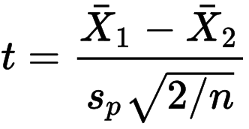
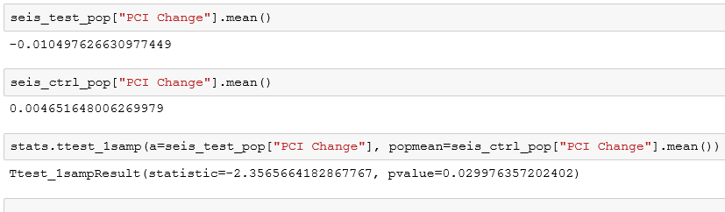
Hypothesis Test
Test performed using t-Test
Test shows a significant level with a
p-value of 0.029976. The analysis concludes that 2013 earthquakes with a magnitude of light to moderate causes a decline in
Per Capita Income by 1.05%
p-value= 0.029976

Slide 7
Q:
Did the 2013 earthquakes caused an increase in Natural Resources and Construction Employment on affected Cities the year after the event?

Slide 8
Test Population
19 Zips that experienced Light to Moderate Magnitude of Seismic Activity in 2013
Year_x | Name_x | Zip | Population_x | Emp Ntrl Rsrces Const_x | Emp Const Extrctn_x | Year_y | Population_y | Emp Ntrl Rsrces Const_y | Emp Const Extrctn_y | Emp Const Extr Change
2013 | ZCTA5 96130 | 96130 | 21963 | 319 | 82 | 2014 | 21920 | 294 | 145 | 0.094763092
2013 | ZCTA5 89406 | 89406 | 24572 | 1261 | 372 | 2014 | 24347 | 1427 | 379 | 0.105939988
2013 | ZCTA5 95501 | 95501 | 23704 | 1136 | 754 | 2014 | 23769 | 943 | 685 | -0.138624339
2013 | ZCTA5 93117 | 93117 | 54251 | 1194 | 574 | 2014 | 55064 | 1443 | 655 | 0.186651584
2013 | ZCTA5 82520 | 82520 | 13778 | 774 | 475 | 2014 | 13840 | 837 | 484 | 0.057646117
2013 | ZCTA5 73013 | 73013 | 46457 | 1353 | 707 | 2014 | 47166 | 1326 | 673 | -0.02961165
2013 | ZCTA5 95422 | 95422 | 15427 | 806 | 395 | 2014 | 15453 | 931 | 317 | 0.039134055
2013 | ZCTA5 73020 | 73020 | 21499 | 1228 | 712 | 2014 | 22063 | 1349 | 743 | 0.078350515
2013 | ZCTA5 95540 | 95540 | 12877 | 618 | 283 | 2014 | 13012 | 604 | 316 | 0.02108768
2013 | ZCTA5 75964 | 75964 | 19648 | 1365 | 903 | 2014 | 19060 | 1114 | 867 | -0.12654321
2013 | ZCTA5 93555 | 93555 | 32376 | 1602 | 685 | 2014 | 32967 | 1558 | 697 | -0.013992129
2013 | ZCTA5 93561 | 93561 | 34851 | 1557 | 752 | 2014 | 34246 | 1500 | 652 | -0.067994803
2013 | ZCTA5 92284 | 92284 | 24951 | 1260 | 727 | 2014 | 25045 | 1110 | 661 | -0.108706593
2013 | ZCTA5 75652 | 75652 | 16185 | 859 | 605 | 2014 | 16438 | 816 | 539 | -0.074453552
2013 | ZCTA5 89433 | 89433 | 19630 | 950 | 632 | 2014 | 19544 | 974 | 743 | 0.085335019
2013 | ZCTA5 93212 | 93212 | 25618 | 1528 | 310 | 2014 | 25204 | 1643 | 318 | 0.066920566
2013 | ZCTA5 90275 | 90275 | 42051 | 435 | 304 | 2014 | 42420 | 495 | 346 | 0.138024357
2013 | ZCTA5 93436 | 93436 | 54433 | 3084 | 1039 | 2014 | 55176 | 3190 | 1120 | 0.045355324
2013 | ZCTA5 96150 | 96150 | 28686 | 1377 | 822 | 2014 | 28618 | 1324 | 890 | 0.006821282
% NR&C Employment Change = ((2014 Natrl Res-Construc Emp – 2013 Natrl Res-Construc Emp) / 2013 Natrl Res-Construc Emp) * 100
Average % NR&C Empl Change : 1.93%

Slide 9
1.93% Avg Increase in
Employment
Hypothesis:
Light to Moderate
Earthquake caused an increase
In Natural Resources &
Construction employment
the year after the event

Slide 10
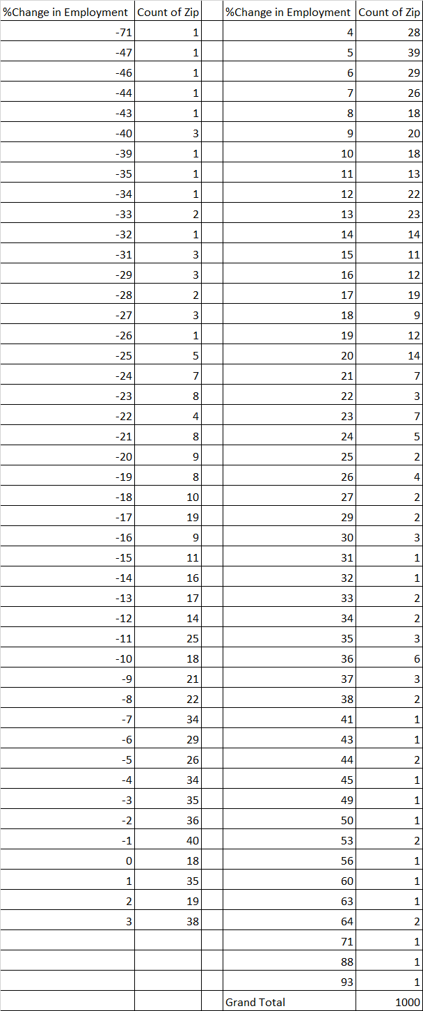
Hypothesis Test
Control Population
Using 1,000 random Control population of Zips across the US.

Slide 11
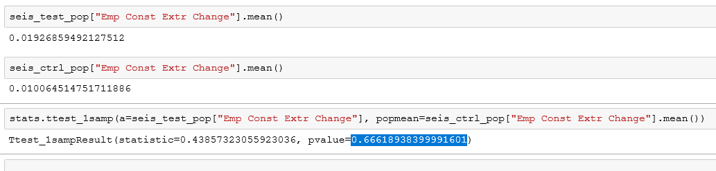
Hypothesis Test
Test performed using t-Test
The test is not significant enough to reject the null hypothesis, with a
p-value of 0.6661.
Hence, the increase of employment in Natural Resources and Construction the year following the 2013 earthquakes is driven by other factors and not by the year’s seismic events.
p-value= 0.666189

